Slide 1
Course Contents
Introduction
Linked Lists
Stacks and Queues
Trees
Graphs
Searching and Sorting Techniques

Slide 2
What is Data Structure?
Data structure is the way to store and organize data in order to facilitate access and modification
OR
The logical or mathematical model of a particular organization of data is called data structure.
Notes:
Data structure : conceptual and concrete ways to organize data for efficient storage and manipulation

Slide 3
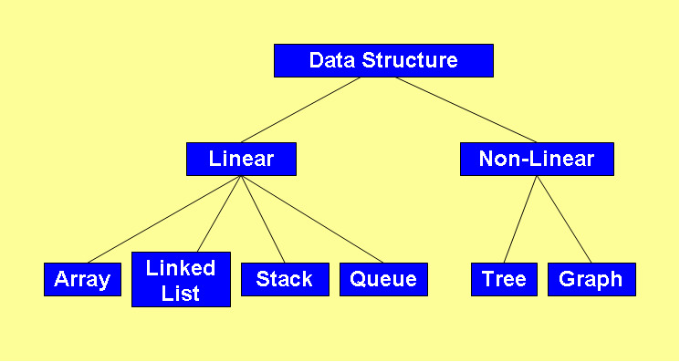
Classification of Data Structure

Slide 4
Programmer’s considerations
How to store data in computer’s memory?
Whether the method works for a hundred file cards? A thousand ? A million?
Whether the method permits quick insertion or deletion?
Whether it allows for fast searching?
Notes:
● How would you store the data in your computer’s memory?
● Would your method work for a hundred file cards? A thousand? A million?
● Would your method permit quick insertion of new cards and deletion of old ones?
● Would it allow for fast searching for a specified card?
● Suppose you wanted to arrange the cards in alphabetical order. How would you sort them?

Slide 5
Pointers
main( )
{
int i = 3;
int *j;
j=&i;
printf(“\nAddress of i = %u”, &i);
printf(“\nAddress of i = %u”, j);
printf(“\nAddress of j = %u”, &j);
printf(“\nValue of j = %d”, j);
printf(“\nValue of i = %d”, i);
printf(“\nValue of i = %d”, *(&i));
printf(“\nValue of i = %d”, *j);
}
Output:
Address of i = 6485
Address of i = 6485
Address of j = 3276
Value of j = 6485
Value of i = 3
Value of i = 3
Value of i = 3

Slide 6
Structures in C
A structure gathers together different atoms of information that form a given entity ➔ structure combines dissimilar data types into a single entity
E.g. Book is described as title, author, call number, publisher, number of pages, date of publication, price etc.

Slide 7
Structures - Example
main()
{
struct account
{
int no;
char name[15];
float balance;
};
struct account a1, a2, a3;
printf(“\nEnter account nos., names and balances\n”);
scanf(“%d %s %f”, &a1.no, a1.name, &a1.balance);
scanf(“%d %s %f”, &a2.no, a2.name, &a2.balance);
scanf(“%d %s %f”, &a3.no, a3.name, &a3.balance);
printf(“\n%d %s %f”, a1.no, a1.name, a1.balance);
printf(“\n%d %s %f”, a2.no, a2.name, a2.balance);
printf(“\n%d %s %f”, a3.no, a3.name, a3.balance);
}
a1.no a1.name a1.balance
4001 4003 4018
Structure Name
375 Sameer\0 1234.55
Structure Elements
Structure Variables

Slide 8
Array of Structures
main()
{
struct account
{
int no;
float balance;
};
struct account a[10];
int i, acn;
float bal;
for (i=0; i<=9; i++)
{
printf(“\nEnter account no. and balance: ”);
scanf(“%d %f”, &acn, &bal);
a[i].no = acn;
a[i].balance = bal;
printf(“\n%d %f”, a[i].no, a[i].balance);
}
}
a[0].no a[0].balance a[1].no a[1].balance a[9].no a[9].balance
4001 4003 4007 4009 4055 4057
375 1234.55 405 2446.60 ---- 209 6489.75

Slide 9
Structures – Points to Remember
One structure can be nested within another structure
struct part
{
char type;
int qty;
};
struct vehicle
{
char maruti[20];
struct part bolt;
}
struct vehicle v;
v.bolt.qty = 300;

Slide 10
Designing Recursive Algorithms
Rules
First, determine the base case
Then determine the general case
Combine the base case and the general cases into an algorithm

Slide 11
Direct Vs Indirect Recursion
Direct recursion occurs when a function or method invokes itself
Indirect recursion occurs when a function or method invokes another function or method, eventually resulting in the original function or method being invoked again

Slide 12
Hanoi Strategy (Generalization)
General strategy for moving N disks from the source peg to the destination peg:
1. Move the topmost N − 1 disks from the source peg to
the extra peg [General Case] A → B
2. Move the largest disk from source peg to destination
peg [Base Case] A → C
3. Move N − 1 disks from the extra peg to the destination
peg [General Case] B → C
12
Notes:
The rules imply that smaller disks must be “out of the way” to move larger disks from one peg to another

Slide 13
Recursive Solution
13
This strategy lends itself to a recursive solution
Step 1 and 3 are the same problems over and over again: move a stack of disks
– the problem size is reduced each time;
– what’s referred to as the destination and extra peg may change each time
The base case for this problem occurs when we want to move a “stack” that consists of only one disk. This step can be accomplished without recursion.

Slide 14
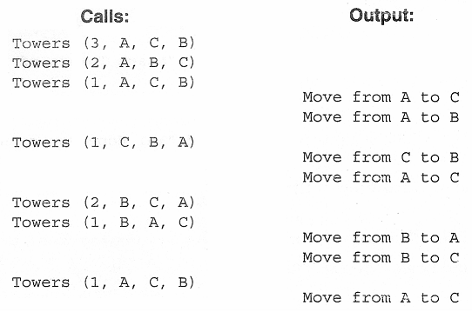
Towers of Hanoi – C Implementation
/* Test Towers of Hanoi */ /* Recursive approach */
#include<stdio.h>
void towers(int n, char source, char dest, char extra);
void main(void)
{
int numDisks;
printf("Please enter number of disks: ");
scanf("%d", &numDisks);
printf("\n\nStart Towers of Hanoi\n\n");
towers(numDisks, 'A', 'C', 'B');
printf("\n\nEnd");
}
void towers(int n, char source, char dest, char extra)
{
static int step = 0;
printf("Towers (%d %c %c %c)\n", n, source, dest, extra);
if (n==1) /* Base case */
printf("\t\t\t Step %3d: Move from %c to %c\n",++step, source, dest);
else /* General case */
{
towers (n-1, source, extra, dest);
printf("\t\t\t Step %3d: Move from %c to %c\n",++step, source, dest);
towers (n-1, extra, dest, source);
}
}
14

Slide 15
Linked Lists
[Module – 2]
WCE - SY (CSE) – CS 212: Data Structures and Files
Subject Teacher: Smriti Bhandari

Slide 16
What to Study?
Concept of linked organization
Singly linked list
Doubly linked list
Circular linked list
Operations
Insertion, deletion, inversion, concatenation, Computation of length, traversal on linked list
Representation & manipulations of polynomials using linked lists
16

Slide 17
Ways to store the data
Arrays
Linked Lists

Slide 18
Linked Lists
Linear collection of data elements called nodes, where the linear order is given by means of pointers
Each node is divided into two parts:
Part 1 : contains information / data
Part 2 : called link field, contains address of the next node in the list

Slide 19
Implementation of Linked Lists
Static Implementation
Using Parallel arrays
Using Array of Structures
Dynamic Implementation

Slide 20
Static Implementation Using Parallel Arrays
Easiest way of implementation
Start=9 ➔ info[9]=‘S’ (first node)
Successor[9]=6 ➔ info[6]=‘O’ (second node)
Successor[6]=5 ➔ info[5]=‘N’ (third node)
Successor[5]=2 ➔ info[2]=‘G’ (fourth node)
Successor[2]=-1 ➔ illegal index value ➔ end of list
Index | Info |  | Successor
0
1
2 | G |  | -1
3
4
5 | N |  | 2
6 | O |  | 5
7
8
9 | S |  | 6
Start

Slide 21
Static Implementation Using Array of Structures
# define MAXNODES 100
struct nodetype
{
int info; /* Information field of node */
int next; /* Pointer to its successor */
}
struct nodetype node[maxnodes];
[Note: next node is represented by an array index]

Slide 22
Linked List
A linear data structure to store data elements
Each node contains two parts:
Part 1: contains information / data
Part 2: contains the address of the next node
(pointer / link)
Elements that are logically adjacent need not be physically adjacent in the memory

Slide 23
Linked List
Basic Operations
Insertion / addition
Deletion
Retrieval
Traversal
Reverse

Slide 24
Algorithm – Insert List Node
Algorithm insertNode (start, pPre, dataIn)
Insert data into a new node in the list
pPre is pointer to data’s logical predecessor
dataIn contains data to be inserted
allocate (pNew)
set pNew data to dataIn
if (pPre NULL)
Adding before first node or to empty list
set pNew link to start
set start to pNew
else
Adding in middle or at end
set pNew link to pPre link
set pPre link to pNew
end if
return true
end insertNode

Slide 25
Algorithm – Delete List Node
Algorithm deleteNode (start, pPre, pLoc, dataOut)
Deletes data from list and returns it to calling module
pPre is a pointer to predecessor node
pLoc is a pointer to node to be deleted
dataOut is variable to receive deleted data
move pLoc data to dataOut
if (pPre NULL)
Deleting first node
set start to pLoc link
else
Deleting other nodes
set pPre link to pLoc link
end if
recycle (pLoc)
end deleteNode

Slide 26
Algorithm – Search Ordered List
Algorithm searchList (start, pPre, pLoc, target)
Searches list and passes back address of node containing target and its logical predecessor
pPre is a pointer to predecessor node
pLoc is a pointer to current node
target is the key being sought
set pPre to null
set pLoc to start
loop (pLoc not null AND target > pLoc key)
set pPre to pLoc
set pLoc to pLoc link
end loop
if (pLoc null)
Set return value
set found to false
else
if (target equal pLoc key)
set found to true
else
set found to false
end if
end if
return found
end searchList

Slide 27
Linked List ADT Implementation
Generic
typedef struct node
{
void* dataPtr;
struct node* link;
} NODE;
E.g. Integer
typedef struct node
{
int data;
struct node* link;
}NODE;
OR
struct node
{
int data;
struct node* link;
};

Slide 28
Doubly Linked List
Two-way list : One can move in either directions from L to R or from R to L
Each node has three parts:
info field : contains data
next pointer field : contains location of the next node (forward pointer)
prev pointer field : contains location of the preceding node (backward pointer)

Slide 29
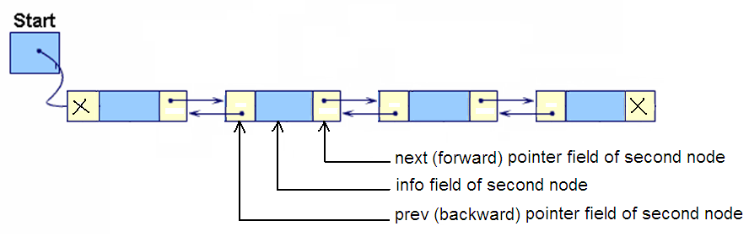
Doubly Linked List

Slide 30
Doubly Linked List
Algorithm insertDbl (start, dataIn)
Insert data into a doubly linked list
dataIn contains the data to be inserted
Return true if successful, false otherwise
Locate insertion point in list
allocate new node
move dataIn to new node
if (pPre is null)
Inserting before first node or into empty list
set new node prev pointer to null
set new node next pointer to start
set start to new node
else
Inserting into middle or end of the list
set new node next pointer to pPre next pointer
set new node prev pointer to pPre
end if
if (pPre next not null or new node next not null)
Inserting in middle of list – point successor to new
set successor prev to new node
end if
set pPre next to new node
return true
end insertDbl

Slide 31
Doubly Linked List - ADT
Struct dblNode
{
int data;
struct dblNode *prev;
struct dblNode *next;
};

Slide 32
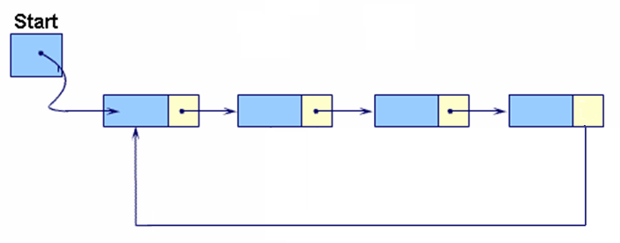
Circular Linked Lists
In Circular linked list, the last node’s link points to the first node of the list

Slide 33
From any point in the list, it is possible to reach any other point in the list
Circular linked list does not have a first and last node (Establish first and last node by convention)
Circular linked list can be used to represent a stack or a queue

Slide 34
Stacks and Queues
[Module – 3]
WCE - SY (CSE) – 1CI 202: Data Structures
Course Teacher: Dr. Smriti H. Bhandari

Slide 35




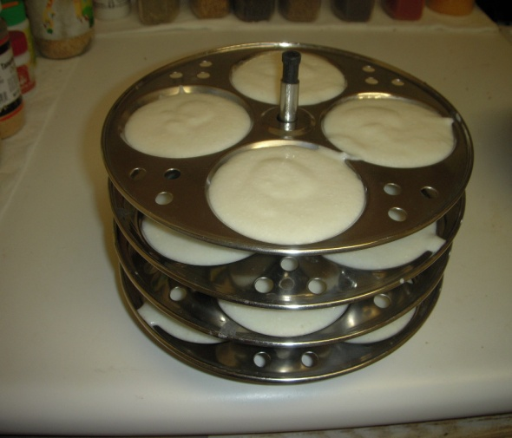
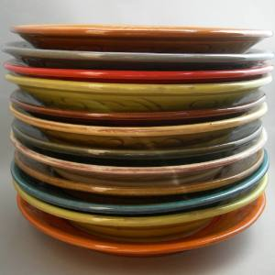
Stack - Introduction
Stack is a linear data structure
Stack is a Last-In-First-Out (LIFO) data structure in which all insertions and deletions are restricted to one end, called the top.
Notes:
The linear lists and arrays discussed in the previous modules allowed one to insert and delete elements at any place on the list at the beginning at the end or in the middle. There are certain frequent situations in computer science when one wants to restrict insertion and deleting so that they can take place only at the beginning or in the end and not in the middle one such data structure that is used for such situation is stacks.

Slide 36
Basic Stack Operations
Push
Used to insert data into the stack
Pop
Used to remove data from a stack and returns the data to calling module
Stack top
Used to return data at the top of the stack without deleting the data from the stack

Slide 37
Ways to implement stacks
Sequential Array Implementation
Linked List Implementation

Slide 38
Stack – Array Implementation
# define MAX 100
struct stack
{
int top;
int data [MAX];
};
struct stack s;

Slide 39
Stack ADT Linked list
typedef struct node
{
void* dataPtr;
struct node* link;
} STACK_NODE;

Slide 40
/* STACKADT – Linked List Implementation – stackADT.h */
# include <stdio.h>
# define TRUE 1
# define FALSE 0
typedef struct stack_node
{
void* dataPtr;
struct stack_node* link;
}STACK;
/* Function to check if stack is empty */
int emptyStack (STACK* pST)
{
if (pST==NULL)
return TRUE;
else
return FALSE;
}
/* Function to push (insert) data into stack */
int push (STACK **pST, void* dataInPtr)
{
STACK* pNew;
pNew= (STACK*) malloc (sizeof(STACK));
if (!pNew)
return FALSE;
else
{
pNew->dataPtr = dataInPtr;
pNew->link = *pST;
*pST = pNew;
return TRUE;
}
}
/* Function to pop (remove) the data from stack */
void* pop (STACK **pST)
{
STACK* pDlt;
void* dataOutPtr;
if ((*pST)!=NULL)
{
pDlt=*pST;
dataOutPtr = pDlt->dataPtr;
*pST=pDlt->link;
free(pDlt);
}
else
{ printf("\nStack Underflow");
dataOutPtr=NULL;
}
return dataOutPtr;
}
/* Function to retrieve stack top data */
void* stackTop(STACK* pST)
{
if (pST==NULL)
return NULL;
else
return (pST->dataPtr);
}

Slide 41
Stack - Applications
Convert Decimal Number to Binary Equivalent
e.g. 45_{D} = 101101_{B}

Slide 42
/* Program to convert Decimal Number to Binary Equivalent using STACK */
# include "stackADT.h"
void main()
{
unsigned int num;
int *digit;
STACK* top;
top = NULL;
printf("\nEnter an integer : ");
scanf("%d", &num);
while (num > 0)
{
digit = (int*) malloc (sizeof(int));
*digit = num % 2;
push (&top, digit);
num = num / 2;
}
while (! emptyStack(top))
{
digit = (int*) pop(&top);
printf("%1d",*digit);
}
printf("\n");
getch();
}

Slide 43
Stack - Applications
Expression Conversions
Infix to Postfix
Infix to Prefix
Postfix to Infix
Postfix to Prefix
Prefix to Infix
Prefix to Postfix

Slide 44
For conversion from infix to postfix we assume the following priorities
Operator Precedence/Priority
------------------------------------------------------------------
Exponent (^ or $) 3
Multiplication (*) or Division (/) 2
Addition (+) or Subtraction (-) 1
Parentheses ( 0

Slide 45
Analysis – Infix to Postfix
Infix Expression : A+B*C
Character Scanned | postFixExpr | Stack
A | A
+ | A | +
B | AB | +
* | AB | +*
C | ABC | +*
 | ABC* | +
 | ABC*+

Slide 46
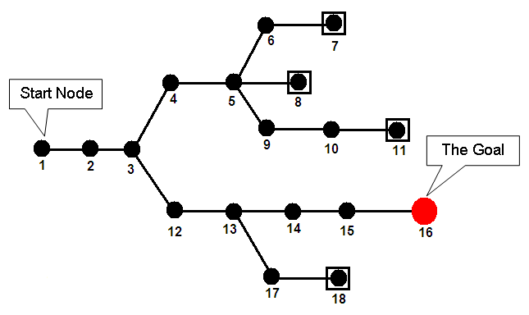
Backtracking – Goal Seeking
Notes:
Another use of stack found in applications like computer games, decision analysis and expert systems.

Slide 47
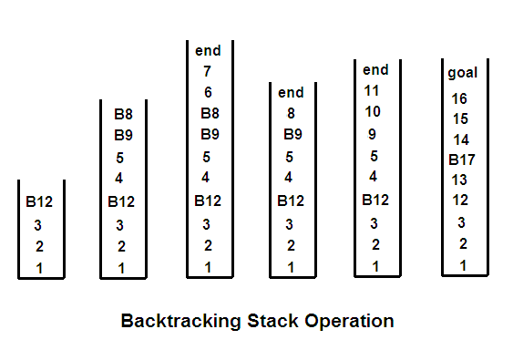
Backtracking – Goal Seeking

Slide 48

Queues
A queue is a linear list in which data can be inserted at one end, called the rear, and deleted from the other end, called front
It is a First-In-First-Out (FIFO) restricted data structure

Slide 49
Queue Implementations
Static Implementation using Array
Dynamic Implementation using Linked List

Slide 50
Queue Implementation - Static
# define MAXSIZE 100
struct queue
{
int front;
int rear;
int data[MAXSIZE];
};
struct queue q;

Slide 51
Queue Operations
Enqueue
Insert an element at the rear of the queue
Dequeue
Delete an element at the front of the queue
Queue Front
Retrieve the element at the front of the queue
Queue Rear
Retrieve the element at the rear of the queue

Slide 52
/* Sample program – QUEUE – Linked List Implementation */
# include <stdio.h>
# define TRUE 1
# define FALSE 0
/* ADT implementation */
struct queue_node
{
char data;
struct queue_node* link;
};
void queue_display (struct queue_node*);
int enqueue (struct queue_node **, struct queue_node**, char);
int dequeue (struct queue_node **, struct queue_node **, char* );
void main()
{
struct queue_node *front, *rear;
char ch;
front = rear = NULL; /* Empty Queue */
printf("\nSimple QUEUE ");
enqueue (&front, &rear, 'A');
enqueue (&front, &rear, 'B');
enqueue (&front, &rear, 'C');
queue_display(front);
dequeue(&front, &rear, &ch);
queue_display(front);
}
/* Function to display the queue contents */
void queue_display(struct queue_node *pQF)
{
printf ("\nQueue contains :\n");
while (pQF != NULL)
{
printf("%c ", pQF->data);
pQF=pQF->link;
}
}

Slide 53
/* Function to insert an element at the end of queue */
int enqueue (struct queue_node **pQF, struct queue_node **pQR , char charIn)
{
struct queue_node* pNew;
pNew= (struct queue_node*) malloc (sizeof(struct queue_node));
if (!pNew)
return FALSE;
else
{
pNew->data = charIn;
pNew->link = NULL;
if (*pQF == NULL)
*pQF = pNew;
else
(*pQR)->link = pNew;
*pQR = pNew;
return TRUE;
}
}
/* Function to remove an element from front of queue */
int dequeue (struct queue_node **pQF, struct queue_node ** pQR, char* charOut)
{
struct queue_node* pDlt;
if (*pQF == NULL)
{
printf (“\nQueue is Empty”);
return FALSE;
}
else
{
pDlt = *pQF;
*charOut = pDlt->data;
*pQF = pDlt->link;
free(pDlt);
return TRUE;
}
}

Slide 54
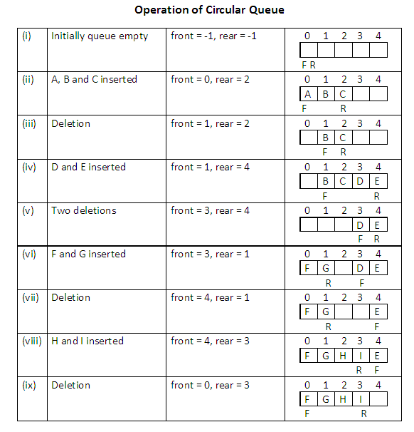
Circular Queue

Slide 55
Circular Queue
The condition to denote “circular queue full” is either one of the below:
front=0 AND rear = MAXSIZE-1
front = rear + 1

Slide 56
Priority Queue
A collection of elements such that each element has been assigned an explicit or implicit priority and such that the order in which elements are deleted and processed comes from the following rules:
An element of higher priority is processed before any element of lower priority
Two elements with the same priority are processed to the order in which they were inserted to the queue
Notes:
Both the stack and queue are data structures whose elements are ordered based on the sequence in which they have been inserted. If there is an intrinsic order among the elements themselves (e.g. numeric or alphabetic order), it is ignored in the stack or queue operations.
The priority queue is a data structure in which the intrinsic ordering of the elements does determine the results of its basic operations.

Slide 57
Priority Queue
Implicit Priority
Priority of element is decided by its value
Explicit Priority
Priority of element is decided by a priority number assigned with each element explicitly

Slide 58
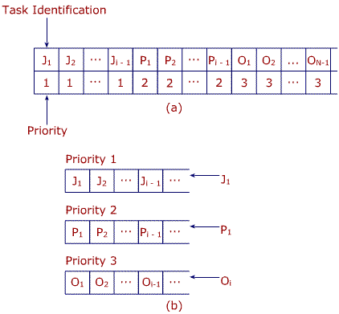
Priority Queue - Multiple
Fig(a) – Single priority queue
Fig (b) – Multiple priority queue
Separate a single priority queue into a series of queues each having its own storage structure
Now whenever elements are inserted, they are inserted in the end of one of the queues determined by their priority instead of inserting in the middle as in the case of single-priority queue, which can require the movement of several items.
➔ Efficient storage representation of a priority queue

Slide 59
Double-Ended Queue (DEQUE)
Elements can be added or removed at either end but not in the middle
Types
Input-restricted DEQUE
Allows insertions at only one end but deletions at both ends
Output-restricted DEQUE
Allows insertions at both ends but deletions at one end

Slide 60
Trees
[Module – 4]
WCE - SY (CSE) – 1CI 202: Data Structures
Course Teacher: Dr. Smriti H. Bhandari

Slide 61
Trees
Basic Terminology
Binary Trees and their representation
Binary tree traversal
Operations on binary tree
Expression Trees
General Trees
Binary Search Trees
Heaps and its operations
Introduction to Multiway Trees
Notes:
A data structure is linear if every item is related (or attached) to its previous and next item(e.g. array, linked list) and it is non-linear if every item is attached to many other items in specific ways to reflect relationships (e.g, n-ary tree). In linear data structure data items are arranged in a linear sequence. In non-linear data structure data items are not in a sequence.
Linear data structure: A linear data structure traverses the data elements sequentially, in which only one data element can directly be reached. Ex: Arrays, Linked Lists
Non-Linear data structure: Every data item is attached to several other data items in a way that is specific for reflecting relationships. The data items are not arranged in a sequential structure. Ex: Trees, Graphs

Slide 62
Basic Terminology – (7)
Root = A
Leaves = {C,D,E,G,H,I}
Parent(E) = A
Siblings(E) = {B,F}
Ancestors(C) = {B,A}
Descendents(F)={G,H,I}
Internal nodes = {B,F}
Height = 3
Level 0
A
Level 1
B
E
F
Level 2
C
D
G
H
I

Slide 63
Properties for binary trees
Height of Binary Trees
Maximum Height
If N nodes are in binary tree, then maximum height,
H_{max} = N
Minimum Height
H_{min} = ⎣log₂N ⎦+ 1
Example: If N = 3 then, H_{max} = 3 and H_{min} = 2

Slide 64
Properties for binary trees – (2)
Minimum Nodes
If H is height of the binary tree, the minimum number of nodes
N_{min} = H
Maximum Nodes
If H is height of the binary tree, the maximum number of nodes
N_{max} = 2^{H} – 1
Example: If H = 3 then, N_{min} = 3 and N_{max} = 7

Slide 65
Representing Binary Trees in Memory
Linked Representation
Using three parallel arrays
Using linked lists
Sequential Representation using single array
Notes:
The main requirement of any representation of tree T is that one should have direct access to the root R of T and, given any node N of T, one should have direct access to the children of N.

Slide 66
Representing Binary Trees in Memory
Index | Info |  | Left |  | Right
0 | K |  | -1 |  | -1
1 | C |  | 2 |  | 5
2 | G |  | -1 |  | -1
3
4 | A |  | 9 |  | 1
5 | H |  | 14 |  | 0
6 | L |  | -1 |  | -1
7
8
9 | B |  | 13 |  | 12
10
11 | F |  | -1 |  | -1
12 | E |  | 11 |  | -1
13 | D |  | -1 |  | -1
14 | J |  | 6 |  | -1
Linked representation using three parallel arrays
Root

Slide 67
Binary Tree Traversals – (2)
Two general approaches to traversal
Depth-first traversal
Breadth-first traversal

Slide 68
Binary Tree Traversals – (3)
Depth-first traversal
Processing proceeds along a path from the root through one child to the most distant descendent of that first child before processing a second child
Process all of the descendents of a child before going on to the next child

Slide 69
Binary Tree Traversals – (4)
Breadth-first traversal
Processing proceeds horizontally from the root to all of its children, then to its children’s children and so forth until all the nodes have been processed
Each level is completely processed before the next level is started

Slide 70
Depth-first Traversal
Preorder
The root of the subtree is processed first, followed by the left subtree and then the right subtree (root, left, right).
Inorder
After the complete processing of the left subtree the root is processed followed by the processing of the complete right subtree (left, root, right).
Postorder
The root is processed only after the complete processing of the left and right subtrees (left, right, root).

Slide 71
Recursive algorithm for Preorder traversal
Algorithm preOrder(root)
//Traverse a binary tree in root-left-right sequence.
if (root is not null)
process (root)
preOrder(leftSubtree)
preOrder(rightSubtree)
end if
End preOrder

Slide 72
Preorder Traversal
A
B
E
C
D
F
A
B
C
D
E
F
Processing Order in Preorder Traversal : A B C D E F

Slide 73
Recursive algorithm for Inorder traversal
Algorithm inOrder(root)
//Traverse a binary tree in left-root-right sequence.
if (root is not null)
inOrder(leftSubtree)
process (root)
inOrder(rightSubtree)
end if
End inOrder

Slide 74
Inorder Traversal
A
B
E
C
D
F
C
B
D
A
E
F
Processing Order in Inorder Traversal : C B D A E F

Slide 75
Recursive algorithm for Postorder traversal
Algorithm postOrder(root)
//Traverse a binary tree in left-right-root sequence.
if (root is not null)
postOrder(leftSubtree)
postOrder(rightSubtree)
process (root)
end if
End postOrder

Slide 76
Postorder Traversal
A
B
E
C
D
F
C
D
B
F
E
A
Processing Order in Postorder Traversal : C D B F E A

Slide 77
Breadth-first tree Traversal
Algorithm breadthFirst(root)
//Process tree using breadth-first traversal
set currentNode to root
createQueue(bfQueue)
loop (currentNode not null)
process(currentNode)
if (left subtree not null)
enqueue(bfQueue, left subtree)
end if
if (right subtree not null)
enqueue(bfQueue, right subtree)
end if
if (not emptyQueue(bfQueue))
set currentNode to dequeue(bfQueue)
else
set currentNode to null
end if
end loop
destroyQueue(bfQueue)
End breadthFirst

Slide 78
Breadth-first tree Traversal
A
B
E
C
D
F
Processing Order in Breadth-first Traversal : A B E C D F

Slide 79
General Trees
Each node can have an unlimited outdegree
Each node may have as many children as is necessary to satisfy its requirements

Slide 80
Binary Search Tree
A Binary Search Tree (BST) is a binary tree with the following properties:
All items in the left subtree are less than the root
All items in the right subtree are greater than or equal to the root
Each subtree is itself a binary search tree

Slide 81
Search BST
Compare 20 with root 23
Searching the given node in the BST
E.g. Search node 20.
Compare 20 with left subtree 18
23
18
44
12
20
35
52

Slide 82
Search BST – (2)
Algorithm searchBST (root, targetKey)
// Searches the BST for a given value
// root is the root of tree or subtree
// targetKey is the key value requested
// Returns the node address if the value is found else returns null
if (empty tree)
return null
end if
if (targetKey < root)
return searchBST (left subtree, targetKey)
else if (targetKey > root)
return searchBST (right subtree, targetKey)
else
return root // found target key
endif
End searchBST

Slide 83
Insertion into BST – (3)
Algorithm addBST (root, newNode)
// Inserts node containing new data into BST using recursion
// root is the address of current node in BST
// newNode is address of node containing data
// Returns the address of new tree root
if (empty tree)
set root to newNode
return newNode
end if
// Locate null subtree for insertion
if (newNode data < root data)
return addBST (left subtree, newNode)
else
return addBST (right subtree, newNode)
end if
End addBST

Slide 84
Deletion from BST
Delete a node from BST
To delete a node
Locate the node
Four possible cases
The node to be deleted has no children ➔ delete the node
The node to be deleted has only a right subtree ➔ delete the node and attach the right subtree to the deleted node’s parent
The node to be deleted has only a left subtree ➔ delete the node and attach the left subtree to the deleted node’s parent
The node to be deleted has two subtrees ➔ the result tends to create very unbalanced trees

Slide 85
Deletion from BST – (2)
The node to be deleted has two subtrees ➔ try to maintain the existing structure as much as possible by finding data to take the place of the deleted data
Find the largest node in the deleted node’s left subtree and move its data to replace the deleted node’s data
OR
Find the smallest node on the deleted node’s right subtree and move its data to replace the deleted node’s data

Slide 86
Deletion – (3)
Algorithm deleteBST (root, dltKey)
// Deletes a node from BST
// root is reference to the node to be deleted
// dltKey is the key of node to be deleted
// if dltKey not found, root unchanged
// Returns true if node deleted, false if not found
if (empty tree)
return false
end if
if (dltKey < root data)
return deleteBST (left subtree, dltKey)
else if (dltKey > root data)
return deleteBST (right subtree, dltKey)
else
// Delete node found – test for leaf node
If (no left subtree)
make right subtree the root
return true
else if (no right subtree)
make left subtree the root
return true
else
// Node to be deleted not a leaf. Find largest node on left subtree
save root in deleteNode
set largest to largestBST (left subtree)
move data in largest to deleteNode
return deleteBST (left subtree of deleteNode, key of largest)
end if
end if
End deleteBST

Slide 87
Program in C to implement BST and Tree Traversals
struct btreenode
{
struct btreenode *LEFT;
int INFO;
struct btreenode *RIGHT;
}

Slide 88
Heaps
Heap is a binary tree with the following properties:
The tree is complete or nearly complete
The key value of each node is greater than or equal to the key value in each of its descendents (➔max-heap)
Subtrees are also heaps
In a heap, root contains the largest (or smallest) element in the tree.

Slide 89
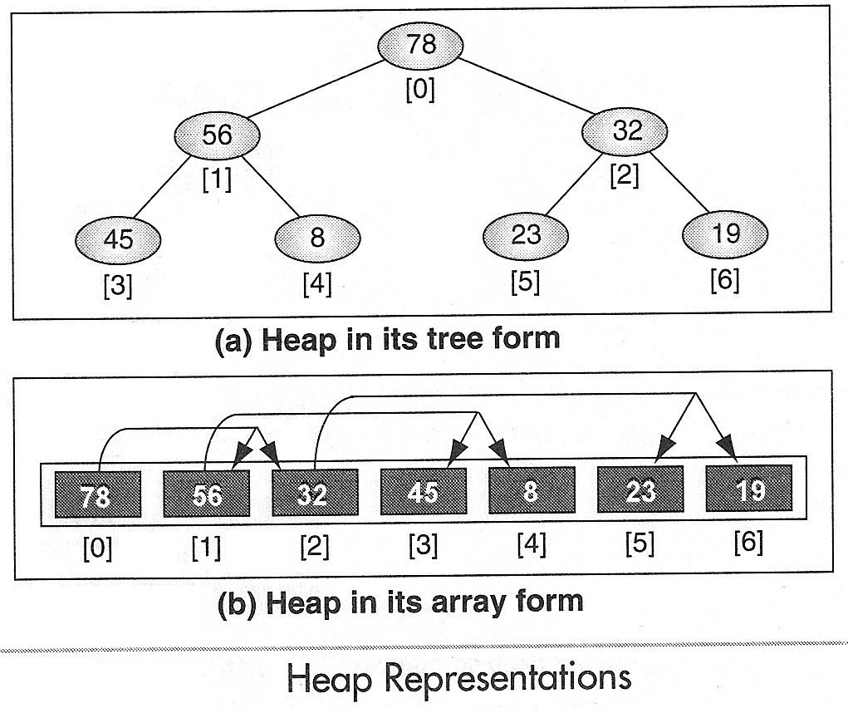
Heap
A heap can be implemented in an array because it must be a complete or nearly complete binary tree, which allows a fixed relationship between each node and its children

Slide 90
Heap Operations
Reheap Up
Reheap Down
Build a Heap
Insert data into heap
Delete Heap Node - (the root)

Slide 91
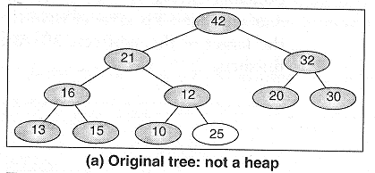
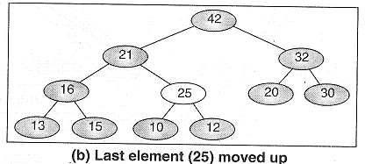
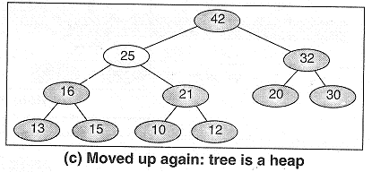
Reheap Up
Reheap up operation reorders a “broken” heap by floating the last element up the tree until it is in its correct location in the heap

Slide 92
Reheap Up
Algorithm reheapUp (heap, newnode)
// Reestablishes heap by moving data in child up to its correct location in the heap array
// heap is array containing an invalid heap
// newNode is index location to new data in heap
if (newNode not the root)
set parent to parent of newNode
if (newNode key > parent key)
exchange newNode and parent
reheapUp (heap, parent)
end if
end if
End reheapUp

Slide 93
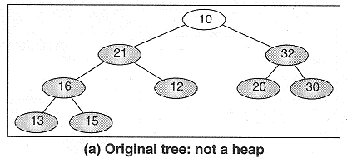
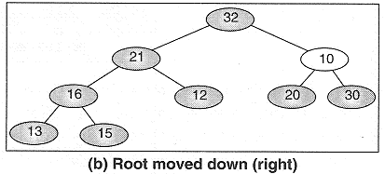
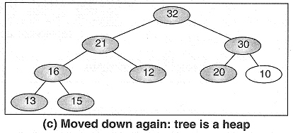
Reheap Down
Reheap down operation reorders a “broken” heap by pushing the root down the tree until it is in its correct location in the heap

Slide 94
Reheap Down
Algorithm reheapDown (heap, root, last)
// Reestablishes heap by moving data in root down to its correct location in the heap array
// heap is array of data, root is root of heap or subheap
// last is an index to the last element in heap
Determine which child has larger key
if (left subtree exists)
set leftKey to left subtree key
if (right subtree exists)
set rightKey to right subtree key
else
set rightKey to null key
end if
if (leftKey > rightKey)
set largeSubtree to left subtree
else
set largeSubtree to right subtree
end if
Test if root > larger subtree
if (root key < largeSubtree key)
exchange root and largeSubtree
reheapDown (heap, largeSubtree, last)
end if
end if
End reheapDown

Slide 95







Build Heap
Notes:
Given a filled array of elements in random order, to build the heap we need to rearrange the data so that each node in the heap is greater than its children. We begin by dividing the array into two parts, the left being a heap and the right being data to be inserted into the heap. At the beginning the root (the first node) is the only node in the heap and the rest of the array are data to be inserted.

Slide 96
Build Heap
Algorithm buildHeap (heap, size)
// Given an array, rearrange data so that they form a heap
// heap is array containing an invalid heap, size is number of elements in array
set walker to 1
loop (walker < size)
reheapUp (heap, walker)
increment walker
end loop
End buildHeap

Slide 97
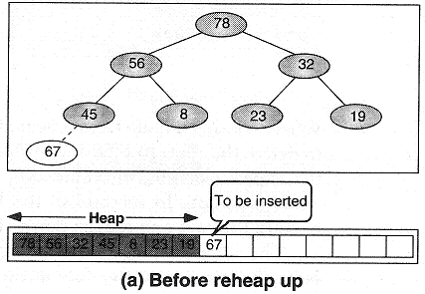
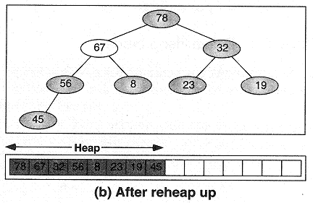
Insert node into Heap

Slide 98
Insert node into Heap
Algorithm insertHeap (heap, last, data)
// heap is an array containing a valid heap
// last is index of last (node) element in heap, data is data to be inserted
// Return true if successful, false if array full
if (heap full)
return false
end if
increment last
move data to last node
reheapUp (heap, last)
return true
End insertHeap

Slide 99
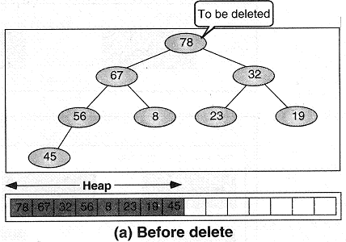
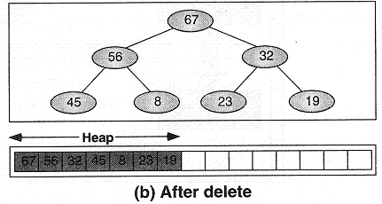
Delete Heap Node

Slide 100
Delete Heap Node
Algorithm deleteHeap (heap, last, dataOut)
// deletes root of heap and passes data back to caller
// heap is an array containing a valid heap
// last is index of last (node) element in heap, dataOut is reference for output
// Return true if successful, false if array empty
if (heap empty)
return false
end if
set dataOut to root data
move last data to root
decrement last
reheapDown (heap, 0, last)
return true
End deleteHeap

Slide 101
Exercise
Build a heap using following data:
44, 33, 11, 55, 77, 90, 40, 60, 99, 22, 88, 66
D, A, T, A, S, T, R, U, C, T, U, R, E, S

Slide 102
Multiway Trees (m-way Trees)
Properties of a nonempty multiway tree:
Each node has 0 to m subtrees
A node with k < m subtrees contains k subtrees and k – 1 data entries
The key values in the first subtree are all less than the key value in the first entry; the key values in the other subtrees are all greater than or equal to the key value in their parent entry
The keys of the data entries are ordered
key₁ ≤ key₂ ≤ … ≤ key_{k}
All subtrees are themselves multiway trees.

Slide 103
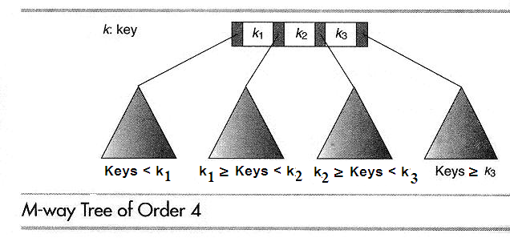
M-way Tree

Slide 104
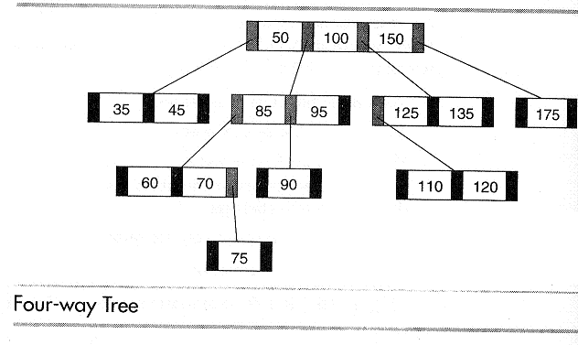
Example

Slide 105
Graphs
[Module – 5]

Slide 106
Basic Concepts
Non-linear data structure
Definition
Graph is
a collection of nodes, called vertices and
A collection of segments or lines called edges/arcs connecting pairs of vertices

Slide 107
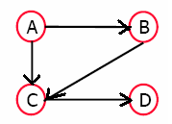
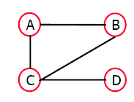
Basic Concepts (4)
Directed graph or digraph
All the edges are directed
Undirected graph
All the edges are undirected

Slide 108
Terminology – (2)
Path
A sequence of vertices v₁ ,v₂ ,. . .v_{k} such that v_{i+1} is adjacent to v_{i} for i = 1 .. k – 1
Simple path
A path with no repeated vertices (i.e. all vertices are distinct)
Cycle
A path except that the last vertex is same as the first vertex
Simple Cycle
A simple path except that the last vertex is same as the first vertex
Cyclic graph
Graph containing a cycle
Acyclic graph
Graph which does not contain a cycle

Slide 109
Terminology – (3)
Connected graph
A graph G is connected if and only if there is a simple path between any two nodes in G
Complete graph
A graph G is said to be complete if every node u in G is adjacent to every other node v in G.
Always connected
A complete graph with n nodes will have n(n-1)/2 edges.

Slide 110
Representation of Graph
Matrix Representation
List Representation
Multilist Representation

Slide 111
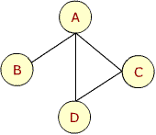
Adjacency Matrix – Example 1
A B C D
A
B
C
D

Slide 112
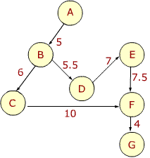
Adjacency Matrix – weighted graph
 | A | B | C | D | E | F | G
A | 0 | 5 | 0 | 0 | 0 | 0 | 0
B | 0 | 0 | 6 | 5.5 | 0 | 0 | 0
C | 0 | 0 | 0 | 0 | 0 | 10 | 0
D | 0 | 0 | 0 | 0 | 7 | 0 | 0
E | 0 | 0 | 0 | 0 | 0 | 7.5 | 0
F | 0 | 0 | 0 | 0 | 0 | 0 | 4
G | 0 | 0 | 0 | 0 | 0 | 0 | 0

Slide 113
Drawbacks of Adjacency matrix representation
Static implementation
A priori knowledge regarding number of nodes in the graph is needed
Dynamic changes in the graph are difficult to model
Wastage of space if matrix is sparse
Not possible to store additional information about the graph
Notes:
The adjacency matrix requires storage for each possible edge between each pair of nodes irrespective of the fact whether the edge exists or not. The space must be reserved for every possible edge even if the adjacency matrix is sparse.

Slide 114
Linked Representation
A linked structure that can make allocation and deallocations of nodes dynamically
Also known as adjacency structure

Slide 115
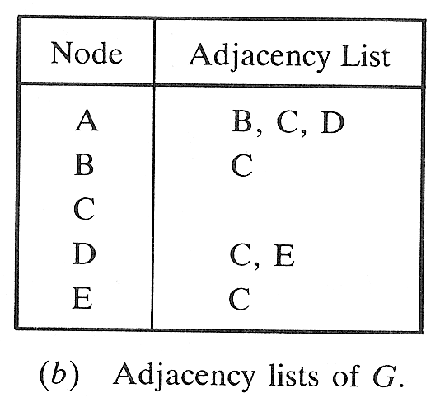
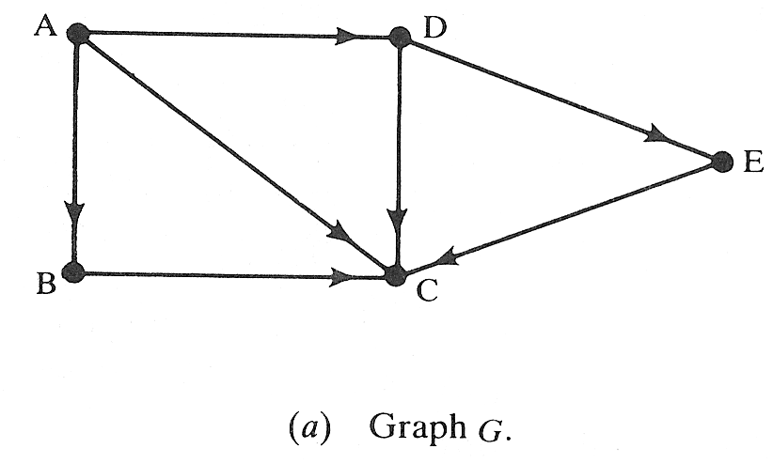
Example

Slide 116
Graph ADT
typedef struct vertex
{
struct vertex* pNextVertex;
void* dataPtr;
struct edge* pEdge;
}VERTEX;
typedef struct edge
{
struct vertex* destination;
struct edge* pNextEdge;
}EDGE;

Slide 117
Traversing a Graph
Breadth First Traversal
Uses a queue as an auxiliary structure to hold nodes / vertices for future processing
Depth First Traversal
Uses a stack as an auxiliary structure to hold nodes / vertices for future processing

Slide 118
Breadth First Traversal - Algorithm
Algorithm BreadthFirstG (graph)
Initialize all nodes to the ready state (STATUS=1)
Put the starting node N in queue (enqueue N) and change its status to the waiting state (STATUS=2)
loop(queue is not empty)
a. Remove the front node N of queue (dequeue N)
b. Process N and change the status of N to the
processed state (STATUS=3)
a. Add to the rear of queue all the neighbors of N
that are in ready state (STATUS=1)
b. Change their status to the waiting state
(STATUS=2)
end loop
end BreadthFirstG

Slide 119
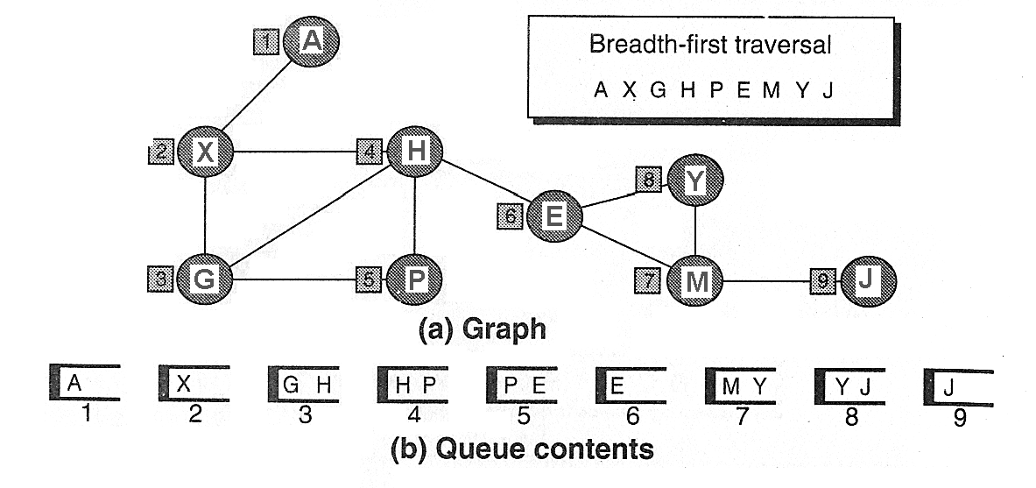
Breadth First Traversal - Example

Slide 120
Depth First Traversal - Algorithm
Algorithm DepthFirstG (graph)
Initialize all nodes to the ready state (STATUS=1)
Push the starting node N onto stack and change to the waiting state (STATUS=2)
loop (stack is not empty)
a. Pop the top node N of stack
b. Process N and change the status of N to the
processed state (STATUS=3)
a. Push onto stack all the neighbors of N that are still
in the ready state (STATUS=1)
b. Change their status to the waiting state
(STATUS=2)
end loop
end DepthFirstG

Slide 121
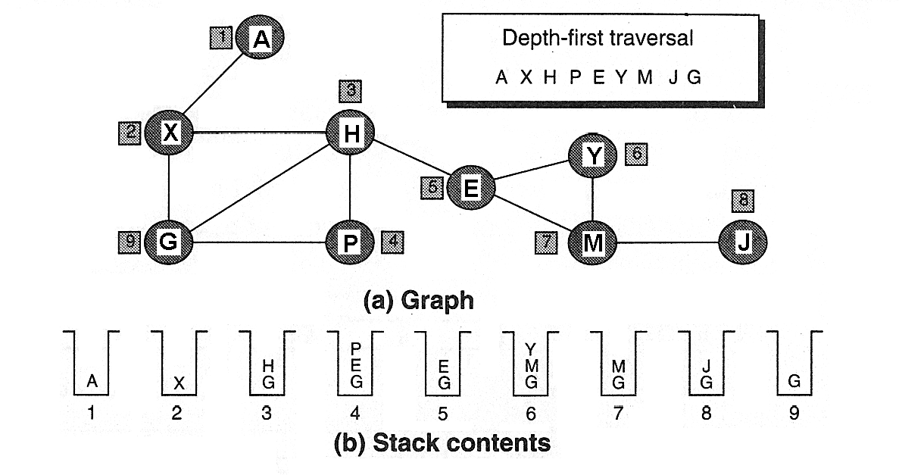
Example

Slide 122
Minimum Spanning Tree
Spanning Tree
A tree that contains all of the vertices in the graph
Minimum Spanning Tree
A spanning tree in which the total weight of the edges is guaranteed to be the minimum of all possible trees in the graph

Slide 123
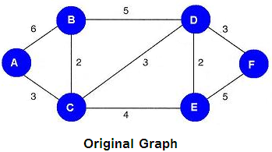
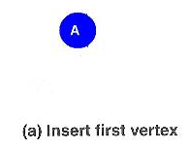
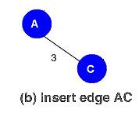
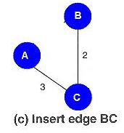
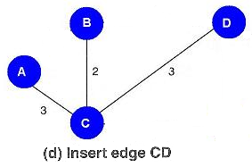
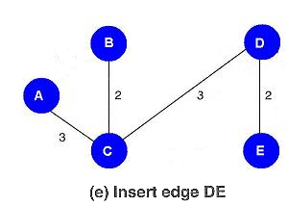
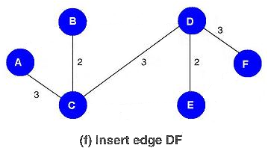
MST - Example
Notes:
Rule:
From all the vertices currently in the tree, select the edge with the minimal value to a vertex not currently in the tree and insert it into the tree.

Slide 124
Searching and Sorting Techniques
[Module – 6]
WCE - SY (CSE) – 1CI 202: Data Structures
Course Teacher: Dr. Smriti H. Bhandari

Slide 125
What to Study?
Searching
Importance of searching
Search Algorithms
Sequential, Binary, Fibonacci
Sorting
Quick sort
Two-way merge sort
Heap sort
Shell sort
Radix sort
125

Slide 126
Complexity of Algorithms
Suppose M is an algorithm and n is the size of the input data.
Two main measures for efficiency of M:
Time
Measured by counting the number of key operations (e.g. comparisons in searching/sorting)
Space
Measured by counting the maximum of memory needed by the algorithm
126
Notes:
Analysis of algorithms is a major task in computer science.
In order to compare algorithms, we must have some criteria to measure the efficiency of our algorithms.

Slide 127
Complexity of Algorithms
Worst case Complexity
The maximum value of f(n) for any possible input
Average case Complexity
The expected value of f(n)
Best case Complexity
The minimum possible value of f(n)
127
Notes:
Analysis of algorithms is a major task in computer science.
In order to compare algorithms, we must have some criteria to measure the efficiency of our algorithms.

Slide 128
Big O Notation
Suppose M is an algorithm and n is the size of input data.
Complexity f(n) of M increases with n.
Important to examine rate of increase of f(n) and done by comparing f(n) with some standard function g(n) such as log₂n, n, n log₂n, n², n³, 2n etc. ➔ use functional O notation ➔ f(n) = O(g(n)) ➔ “f(n) is of order g(n)”

Slide 129
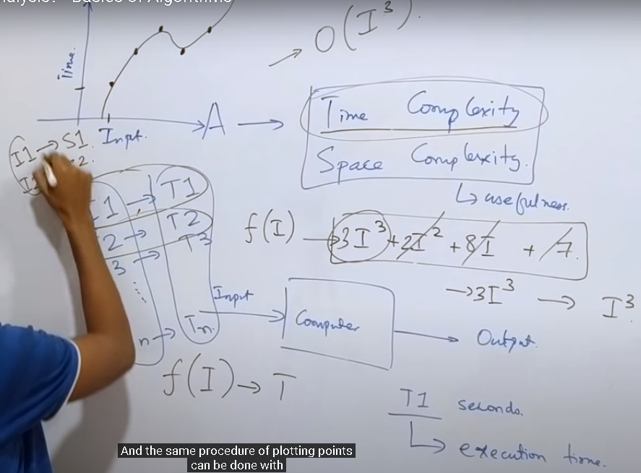
Space and time complexity
129

Slide 130
Searching
130
Sequential Search
Binary Search
Fibonacci Search

Slide 131
Sequential / Linear Search
Searching in a linear list
Element by element comparison with the search key
Used whenever the list is not ordered.
Typically used for small lists or lists that are not searched often.
131

Slide 132
Sequential / Linear Search
Analysis
Best Case
First element itself is the required element
Only one comparison is needed
Best case time complexity is 1
Worst case
None of the element is same as the search element
If the list consists of n elements, then n comparisons are needed
Worst case time complexity is n
Average number of comparisons = (n+1)/2 i.e. order of complexity is O(n) ➔ as power for n is 1 in complexity expression, it is called as linear search algorithm.
Also known as serial or sequential search or brute force search
132
Notes:
Average case
Here we assume that ITEM does appear in DATA, and that is equally likely to occur at any position in this array. Accordingly, the number of comparisons can be any of the numbers 1,2,3,…,n and each number occurs with probability p=1/n, then
C(n) = 1*1/n + 2* 1/n + … + n*1/n
= (1+2+…+n) * 1/n
=(n(n+1)/2 )* 1/n
=(n+1)/2

Slide 133
Binary Search
133
The sequential search is very slow
If the array is sorted, binary search is more efficient
Notes:
Consider binary searches whenever the list contains more than 16 elements.

Slide 134
Algorithm binarySearch (list, last, target, loc)
//Search an ordered list using binary search
//list is ordered and must contain at least one element
//Last is index to largest element in the list
//target contains data to be searched
//loc is address where the found element’s index location is to be stored
//Return found true or false
set begin to 0
set end to last
loop (begin <= end)
set mid to floor((begin + end) / 2)
if (target > list[mid])
// look in upper half
set begin to (mid+1)
else if (target < list[mid])
// look in lower half
set end to (mid-1)
else
// Found: force exit
set begin to (end+1)
end if
end loop
set loc to mid
if (target equal list[mid])
set found to true
else
set found to false
end if
return found
End binarySearch
134

Slide 135
Binary Search
The loop in algorithm divides the search in two halves ➔ logarithmic loop
Efficiency of binary search is O(log n)
135

Slide 136
Fibonacci Search
When the elements being searched have non-uniform access memory storage (i.e. the time needed to access a storage location varies depending on the location previously accessed), the Fibonacci search has an advantage over binary search

Slide 137
Let F be the array of Fibonacci numbers. Let k be an element in F.
n be the array size.
If the array size is not a Fibonacci number, let F_{m} be the smallest number in F that is greater than n.
Let F_{k} represent the k^{th} Fibonacci number where F_{k+2} = F_{k+1} + F_{k} for k>=0 and F₀ = 0, F₁ = 1. Let target is data to be searched
Algorithm: Search an item in a list of n = F_{m} ordered numbers
Set k = m
If k = 0, finish ➔ no match
Compare target against list entry in position F_{k -1}
If match, finish
If target is less than list entry F_{k -1}, discard list entries from positions F_{k -1} + 1 to n
Set k = k - 1 and go to 2
If target is greater than entry F_{k-1}, discard list entries from positions 1 to F_{k-1}
Renumber remaining list entries from 1 to F_{k-2}, set k = k-2 and go to 2
If F_{m}>n then the original array is augmented with F_{m -n} numbers larger than target and the above algorithm is applied.
137
Notes:
Fibonacci search has an advantage over binary search in slightly reducing the average time needed to access a storage location.
The typical example of non-uniform access storage is that of a magnetic tape, where the time to access a particular element is proportional to its distance from the element currently under the tape's head. Note, however, that large arrays not fitting in cache or even in RAM can also be considered as non-uniform access examples. Fibonacci search has a complexity of O (log(n)) (see Big O notation).

Slide 138
Fibonacci Search
Complexity of Fibonacci search is O(log n)

Slide 139
Sorting
139
Classification
Internal Sort
All the data are held in primary memory during the sorting process
External Sort
Uses primary memory for the data currently being sorted and secondary storage for any data that does not fit in primary memory

Slide 140
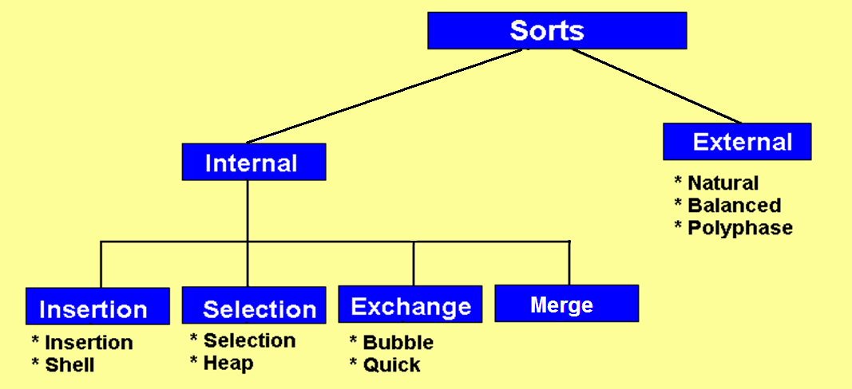
Sorting
140

Slide 141
Insertion Sort
Most common sorting techniques used by card players
In each pass of an insertion sort, one or more pieces of data are inserted into their correct location in an ordered list

Slide 142
Straight Insertion Sort
Algorithm StraightInsertionSort (list, last)
//sort the list in ascending order.
//list must contain at least one element
//last is index to last element in the list
set current to 1
loop (current <= last) //loop until last element is sorted
set temp to list [current]
set walker to current - 1
loop (temp < list[walker] AND walker>=0)
//move walker element right one element
set list[walker+1] to list[walker]
decrement walker
end loop
set list[walker + 1] to temp
increment current
end loop
End StraightInsertionSort

Slide 143
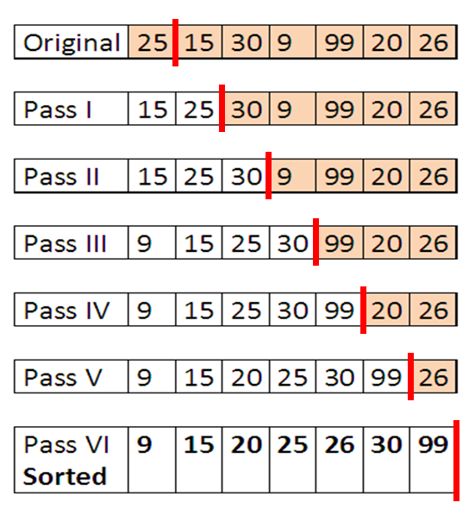
Straight Insertion Sort - Example
To sort an array with n elements Insertion sort requires n-1 passes

Slide 144
Straight Insertion Sort
Efficiency is O(n²)
The outer loop executes n-1 times.
For each outer loop the inner loop executes from 0 to
current times,
depending on the relationship between the temp key
and walker key.
On the average, we expect the inner loop to process
through the data
in half of the sorted list. Because the inner loop depends
on the setting
for current, which is controlled by the outer loop, we have
a dependent
quadratic loop, which is mathematically stated as
F(n) = n ((n+1)/2) ➔ O(n2)
Notes:
The outer loop executes n-1 times.
For each outer loop the inner loop executes from 0 to current times, depending on the relationship between the temp key and walker key.
On the average, we expect the inner loop to process through the data in half of the sorted list. Because the inner loop depends on the setting for current, which is controlled by the outer loop, we have a dependent quadratic loop, which is mathematically stated as
F(n) = n ((n+1)/2) ➔ O(n2)

Slide 145
Shell Sort
List of N elements is divided in K segments where K is increment.
Each segment contains minimum of integral N/K elements

Slide 146
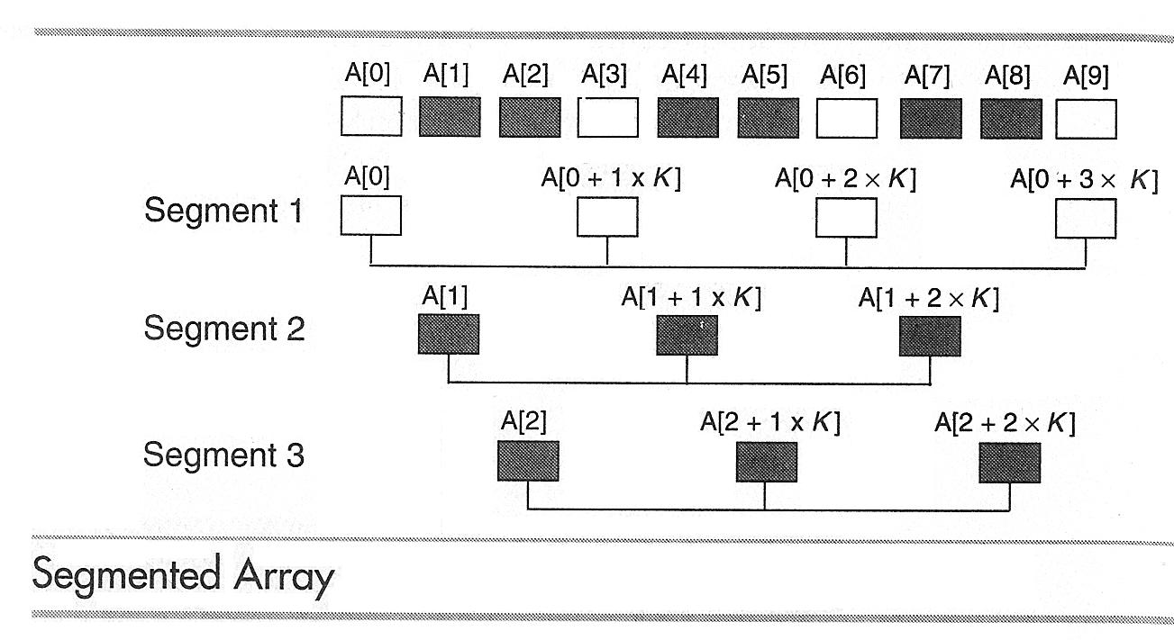
Shell Sort
N = 10, K = 3
If elements are out of sequence then exchange
After each pass increment is reduced until in the final pass it is 1
Compare A[0] and A[3] from first segment
Compare A[1] and A[4] from second segment
Compare A[2] and A[5] from third segment
Compare A[3] and A[6] from first segment …………
Finally compare A[6] and A[9].

Slide 147
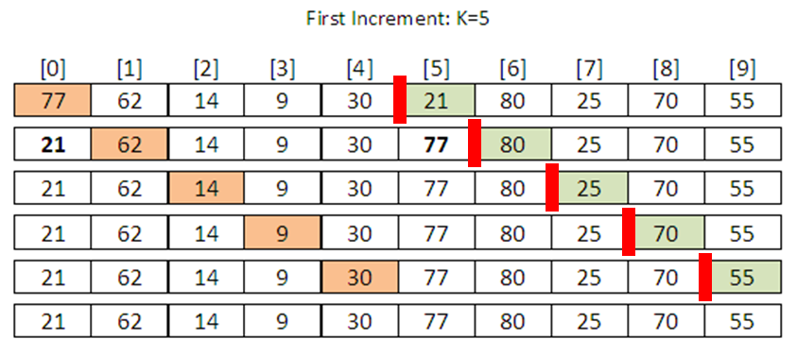
Shell Sort - Example

Slide 148
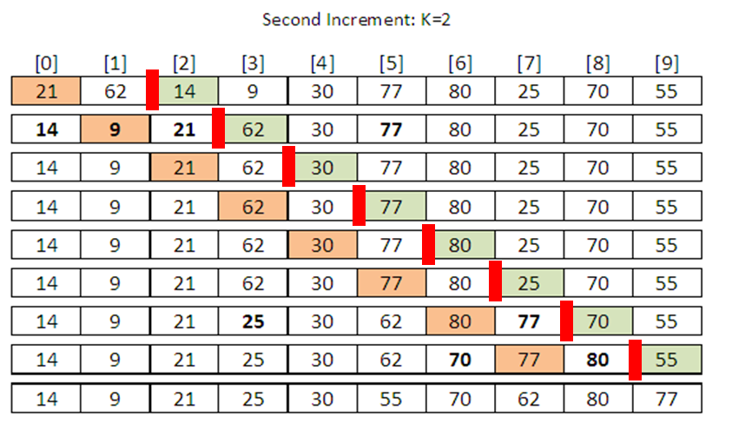
Shell Sort - Example
Seg# 1 2 1 2 1 2 1 2 1 2

Slide 149
Shell Sort - Algorithm
Algorithm ShellSort (list, last)
//sort (in-place) the list in ascending order.
//last is index to last element in the list, k is increment
set k to last/2
//compare keys “increment” elements apart
loop (k not 0)
set current to k
loop (until last element sorted)
set hold to list[current]
set walker to current-k
loop (walker>=0 AND hold < list[walker])
//move larger element up in list (segment)
move list[walker] one increment right
//fall back one partition
set walker to walker-k
end loop
//Insert hold in proper relative location
set list[walker+k] to hold
increment current
end loop
//End of pass – calculate next increment
set k to k/2
end loop
End ShellSort

Slide 150
Shell Sort
Decision to select optimal Increment size varies
Efficiency is O(n ^{1.25})
Notes:
No increment size is best for all situations.
Important consideration in sort: to complete sort with minimum number of passes. Here minimum number of increments and to minimize the number of elements that appear in more than one segments.
Solution 1: use prime numbers as increments. But dynamic calculation of prime numbers is relatively slow.
Solution 2: setting the increment to half the list size and dividing by 2 on each pass.
According to Knuth, we should not start with k > one third of the list size.
Solution 3: increments be the power of 2 minus 1 or a fibonacci series. ➔ slightly more efficient but complex.
Solution 4: division-by-2 approach with variation. Add 1 if increment is even ➔ reduce number of elements that appear in more than one segments.

Slide 151
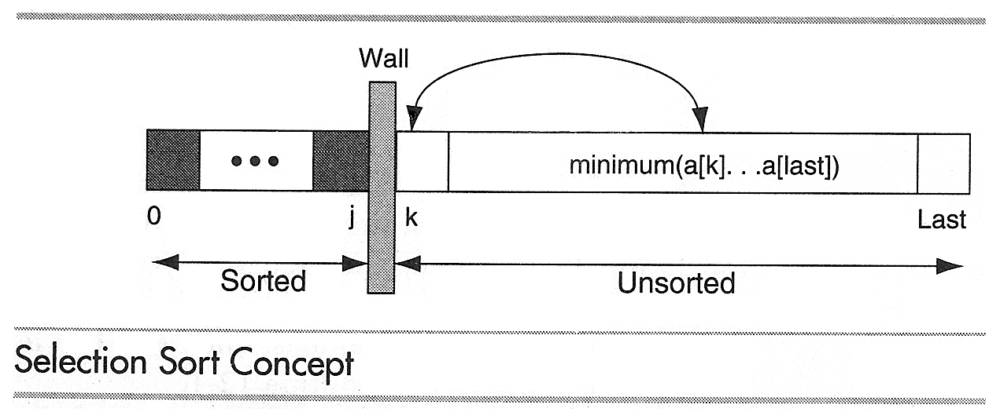
Selection Sort
In each pass of the selection sort, the smallest element is selected from the unsorted sublist and exchanged with the element at the beginning of the unsorted list

Slide 152
Straight Selection Sort
Algorithm StraightSelectionSort (list, last)
//sort the list in ascending order.
//list must contain at least one element
//last is index to last element in the list
set current to 0
loop (current <= last) //loop until last element is sorted
set smallest to current
set walker to current + 1
loop (walker <= last)
if (walker key < smallest key)
set smallest to walker
end if
increment walker
end loop
//smallest selected : exchange with current element
exchange (current, smallest)
increment current
end loop
End StraightSelectionSort

Slide 153
Heap Sort
Steps in Algorithm
Turn the array to be sorted into a heap
Repeat step 3 and 4 until the entire list is sorted
Exchange the root (the largest element in the heap) with the last element in the unsorted list ➔ results in the largest elements being added to the beginning of sorted list
Reheap the unsorted list

Slide 154
Heap Sort
Efficiency of heap sort is O(n log n)
Efficiency of straight selection sort is O(n²)

Slide 155
Exchange Sorts
Exchange elements that are out of order until the entire list is sorted
Virtually every sorting method uses some form of exchange, the sorts under this category use it extensively

Slide 156
Exchange Sorts
Bubble Sort
The most common sort
Quick Sort
The most efficient general purpose sort

Slide 157
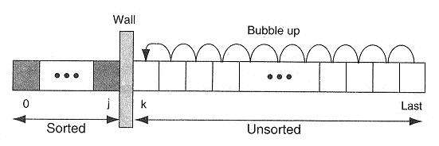
Bubble Sort Concept

Slide 158
Algorithm BubbleSort (list, last)
//sort the list in ascending order.
//list must contain at least one element
//last is index to last element in the list
set current to 0
set sorted to false
loop (current <= last AND sorted false)
//Each iteration is one sort pass
set sorted to true
set walker to last
loop (walker > current)
if (walker key < walker - 1 key)
set sorted to false
swap (walker, walker-1)
end if
decrement walker
end loop
increment current
end loop
End bubbleSort

Slide 159
Quick Sort
159
Most popular sorting technique
Developed by C.A.R. Hoare
In-place, Divide and conquer, Massively recursive sort
Simple in theory but difficult to put into the code

Slide 160
Quick Sort
Divide-and-conquer algorithm
Divide: partition array into 2 subarrays such that elements in the lower part <= elements in the higher part
Conquer: recursively sort the 2 subarrays
Combine: sorting is done in-place

Slide 161
Quick Sort
161
The recursive algorithm consists of four steps:
If there are one or less element in the array to be sorted, return immediately
Pick an element in the array to serve as a “pivot” point. (Usually the left-most element in the array is used.)
Split the array into three parts –
A partition of elements less than the pivot
The pivot element
A partition of elements greater than or equal to the pivot
Recursively quick sort the left partition followed by quick sort the right partition

Slide 162
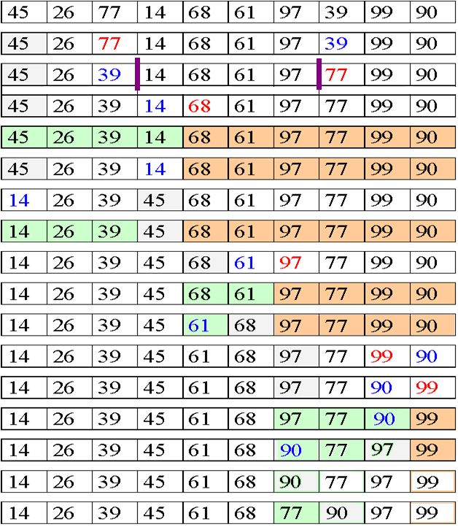
Pivot = 45
Cross Over low>high
Fix position of pivot
Three parts
1st element is pivot, now start two traversal, from left, find the first element > pivot
And from right find 1st element < pivot, then exchange them, continue till left<=right
Then exchange pivot with current left index value. This pass you will get all elements
On left of pivot less then pivot and on tight > pivot. Continue this process till

Slide 163
Quick Sort - Algorithm
Algorithm QuickSort(a,l,h)
//a is list of elements
//l is the position of the first element in the list
//h is the position of the last element in the list
Step 1: low = l+1, high = h, pivot = a[l]
Step 2: Loop (low < high)
// beginning from left find first element greater than pivot
Loop (a[low] <= pivot and low<=h )
increment low
End loop
// beginning from right find first element smaller than pivot
Loop (a[high] > pivot)
decrement high
End loop
// check the cross over
if (low < high)
swap(a[low],a[high])
increment low
decrement high
end if
End Loop
a[l]=a[high]
a[high]=pivot // Fix the position of pivot
Step 3: if (l<high) QuickSort(a,l,high-1)
Step 4: if (low<h) QuickSort(a,high+1,h)
Step 5: Return
End QuickSort
163

Slide 164
Complexity of Quick Sort
Most efficient when the pivot key is in the middle of the array (we can use median value as pivot key)
Complexity of Quick Sort is
O(n log n)
164

Slide 165
Merge Sort
Given an array
Form the sorted subarrays
Go on merging the pairs of sorted subarrays

Slide 166
Merge Sort - Example
Array size, n = 14
66, 33, 40, 22, 55, 88, 60, 11, 80, 20, 50, 44, 77, 30
Pass 1: Merge each pair of elements ➔ list of sorted pairs
33, 66, 22, 40, 55, 88, 11, 60, 20, 80, 44, 50, 30, 70
Pass 2: Merge each pair of pairs ➔ list of sorted quadruplets
22, 33, 40, 66, 11, 55, 60, 88, 20, 44, 50, 80, 30, 70
Pass 3: Merge each pair of sorted quadruplets ➔ sorted subarrays
11, 22, 33, 40, 55, 60, 66, 88, 20, 30, 44, 50, 70, 80
Pass 3: Merge two sorted subarrays ➔ single sorted array
11, 20, 22, 30, 33, 40, 44, 50, 55, 60, 66, 70, 80, 88

Slide 167
Merge Sort
Algorithm requires at most log n passes to sort an array of size n
Complexity is O(n log n)

Slide 168
Radix Sort
The method that we intuitively use to arrange list of names alphabetically
Here radix is 26 as there are 26 alphabets
➔ 26 pockets
Put names in appropriate pocket considering first alphabet in the name ➔ first pass
Put names in appropriate pocket considering second alphabet in the name ➔ second pass
Same process continues till the last alphabet in the longest name gets processed ………..

Slide 169
Radix Sort
If the list to be sorted includes numbers, then radix is 10 as there are 0,1, 2 …. 9 digits
➔ 10 pockets
Put numbers in appropriate pocket considering least significant bit ➔ first pass
Put numbers in appropriate pocket considering second significant bit ➔ second pass
Same process continues till the most significant bit of the largest number is processed ………..

Slide 170
Radix Sort - Example
The list to be sorted is
121, 70, 965, 432, 12, 577, 683
List after Pass-1 : 70, 121, 432, 12, 683, 965, 577
Pass-1
Input | 0 | 1 | 2 | 3 | 4 | 5 | 6 | 7 | 8 | 9
121 |  | 121
70 | 70
965 |  |  |  |  |  | 965
432 |  |  | 432
12 |  |  | 12
577 |  |  |  |  |  |  |  | 577
683 |  |  |  | 683

Slide 171
Radix Sort - Example
Input for Pass-2
70, 121, 432, 12, 683, 965, 577
List after Pass-2 : 12, 121, 432, 965, 70, 577, 683
Pass-2
Input | 0 | 1 | 2 | 3 | 4 | 5 | 6 | 7 | 8 | 9
70 |  |  |  |  |  |  |  | 70
121 |  |  | 121
432 |  |  |  | 432
12 |  | 12
683 |  |  |  |  |  |  |  |  | 683
965 |  |  |  |  |  |  | 965
577 |  |  |  |  |  |  |  | 577

Slide 172
Radix Sort - Algorithm
Algorithm RadixSort(list, last)
//list is a list of elements
//last is the position of the last element in the list
Step 1: Find the largest element of the array
Step 2: set len to length of largest element
set pass to 1
set radix to 10
declare 10 arrays of size last+1
pocket[][radix]
Step 3: Loop ( pass <= len)
set k to 0
Loop (k<=last)
set digit to (pass) significant bit
put list[k] in pocket[k][digit]
End loop
Loop (r<radix)
End Loop
Step 3: if (l<high) QuickSort(a,l,high)
Step 4: if (low<h) QuickSort(a,low,h)
Step 5: Return
End QuickSort

Slide 173
Comparison of Sorting algorithms
Sort | Average | Best | Worst | Space | Stability
Insertion Sort | O(n²) | O(n) | O(n²) | Constant | Stable
Shell Sort | O(n^{1.25}) | O(n^{1.25}) | O(n²) | Constant | Stable
Selection Sort | O(n²) | O(n²) | O(n²) | Constant | Stable
Heap Sort | O(n log n) | O(n log n) | O(n log n) | Constant | Unstable
Quick Sort | O(n log n) | O(n log n) | O(n²) | Constant | Stable
Merge Sort | O(n log n) | O(n log n) | O(n log n) | Not constant | Stable
Radix Sort | O(n log n) | O(n log n) | O(n²) | Not Constant | Stable

Slide 174
External Sorts
External sorts allow portions of the data to be stored in secondary memory during the sorting process
Steps
Sorting blocks of data internally and writing them into files
Once all the data have been sorted internally, merging of these sorted files

Slide 175
Hashed List Searches
Goal : To find the data with only one test
The key, through an algorithmic function, determines the location of the data
Hashing is a Key-to-address mapping process
Notes:
Earlier search techniques require several tests before we can find the data.

Slide 176
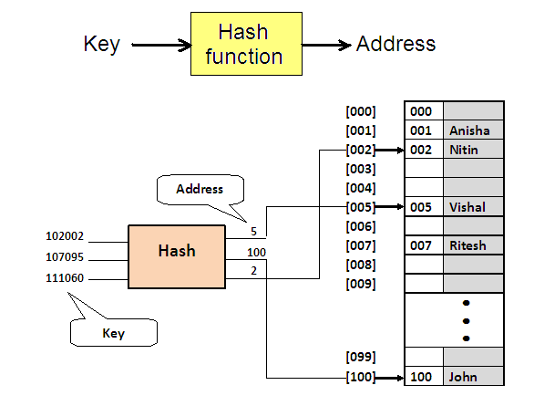
Hash Concept

Slide 177
Hash Concept
Set of keys that hash to the same location – Synonyms
If the actual data to be inserted contain two or more synonyms – collision occurs

Slide 178
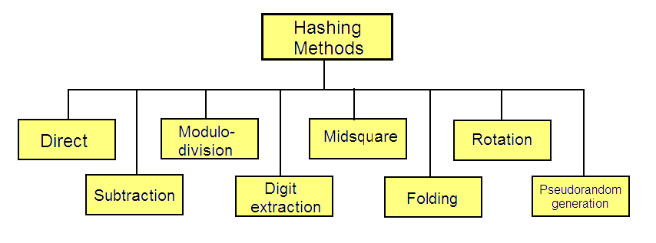
Hashing Methods

Slide 179
Direct Hashing
The key is the address without any algorithmic manipulation
Limited use
Very powerful because
No synonyms
No collisions

Slide 180
Subtraction Method
Used when keys are consecutive but do not start from 1
Hash function subtracts a number from the key to determine the address
Simple method : No collisions
Used only for small lists in which the keys map to a densely filled list

Slide 181
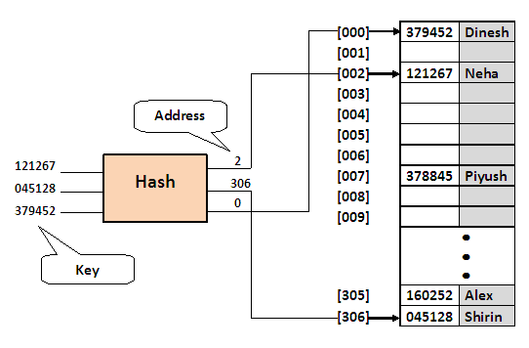
Modulo-division - Example
To provide data space for up to 300 employees. First prime number greater than 300 is 307➔ choose 307 as list size
Neha’s employee number = 121267
121267/307 = 395 with remainder of 2
➔ hash(121267) = 2

Slide 182
Digit-extraction Method
Selected digits are extracted from the key and used as the address
E.g. using six-digit number to hash to a three-digit address (000-999)
379452 394
121267 112
378845 388
160252 102
045128 051

Slide 183

Folding Method - Example

Slide 184

Rotation Method - Example

Slide 185
Pseudorandom Hashing
The key is used as the seed in a pseudorandom-number generator, and the resulting random number is then scaled into the possible address range using modulo-division
Given a fixed seed, pseudorandom-number generators always generate the same series of numbers

Slide 186
Pseudorandom Hashing
A common random-generator is
y = ax + c
Set x to the key
Compute y and divide it by list size ➔ remainder is hashed address
For maximum efficiency a and c should be prime numbers

Slide 187
Pseudorandom Hashing - Example
If key = 121267, a = 17 and c = 7 then
y = ((17 * 121267) + 7) modulo 307
y = 2061546 modulo 307
y = 41

Slide 188
All hash functions except direct hashing and subtraction hashing are many-to-one functions ➔ many keys hash to one address ➔ create collision ➔ Collision Resolution methods required

Slide 189

Collision Resolution Methods
Notes:
With the exception of the direct and subtraction methods, none of the methods used for hashing is one-to-one mapping. Thus when we hash a new key to an address, we may create a collision.
The methods for handling collisions are independent of the hashing algorithms. That is, each hashing method can be used with each of the collision resolution methods.

Slide 190
Collision Resolution
There must be some empty records / elements in a list at all times
As a rule, a hashed list should not be allowed to become more than 75% full
➔ load factor

Slide 191
Collision Resolution – Open Addressing
Linear Probing
Simplest method
Resolve the collision by adding 1 to the current address

Slide 192
Collision Resolution – Open Addressing
Double Hashing
Minimizes clustering in linear probing
A second hash function H’ is used for resolving a collision
Suppose a record R with key k has the hash addresses H(k) = h and H ’(k) = h ’ ≠ m. Then we linearly search the locations with addresses
h, h + h’, h + 2h’, h + 3h’, …
If the number m of the locations in the table T is a prime number, then the above sequence will access all the locations in T.

Slide 193
Collision Resolution – Linked Lists
Uses a separate area to store collisions and chains all synonyms together in a linked list
Uses two storage areas: the prime area and the overflow area
Each record in the prime area contains an additional field – a link to a linked list of overflow data in the overflow area

Slide 194

Collision Resolution – Linked Lists

